Slide 1
NETWORK FUNDAMENTALS

Slide 2
Software: Software is a set of instructions, data or programs used to operate computers and execute specific tasks.
Types of Software:
1.Application software: Application software is a computer software package that performs a specific function for a user.
2.System software: These software designed to run a computer's application programs and hardware.
3.Driver software(Device drivers):Device drivers control the devices and peripherals connected to a computer, enabling them to perform their specific tasks.

Slide 3
4.Middleware:The term middleware describes software that mediates between application and system software or between two different kinds of application software.
5.Programming software: Computer programmers use programming software to write code. Programming software and programming tools enable developers to develop, write, test and debug other software programs.
6.Malware, or malicious software: Are types of software that threatens the security of the computer system.
7.recovery software: Also called backup software.

Slide 4
Operating System: An operating system (OS) is system software that manages computer hardware, software resources, and provides common services for computer programs.
Types of operating system:
1.UNIX
2.Window
3. MacOS.

Slide 5
History of UNIX
UNIX was created by one of the Bell Labs member, Kenneth Thompson in 1969. This was intended for programmers to “access the computer at the same time and share its resources” (“Alcatel Lucent”). UNIX controls the commands from the keyboard, and the data being generated. Also, it “permits each user to believe he or she is the only person working on the computer” (“Alcatel Lucent”). This operating system became so powerful that industries, governments, businesses, and so forth wanted this operating system. This idea became popular in the programming and scientific communities.
Based on this superior operating system, its features were: Multitasking capability, multiuser capability, portability, UNIX programs, and Library of application software.

Slide 6
History of Window
In 1975, Paul Allen and Bill Gates saw an article regarding about the MITS Altair 8800 (a microcomputer). They had a better idea and decided it was their time to do something about it. Based on that, they developed and formed Microsoft Corporation in 1975.
On November 20, 1985, Microsoft launched Windows 1.0. This was the first display screen where you could use your mouse, type, and see the screen.
Microsoft Windows 2.0 was released on December 9, 1987; this includes expanded memory and provided desktop icons.
Window 3.0 was released on May 22, 1990 followed by Windows 3.1 in 1992. Windows 3.0 had “better performance, advanced graphics with 16 colors, and improved icons”.
Windows NT was released on July 27, 1993. This however, provided a 32-bit operating system generally for business platform.

Slide 7
History of Window
On August 24, 1995, Microsoft launched Windows 95. It sold about seven million copies by the end of the fifth week. With this creation, it led to the start menu, close, maximize, and minimize, and taskbar in Windows 95.
In 1998 to 2000, Microsoft released Windows 98, Windows 2000, and Windows Me. Windows 98 was released on June 25, 1998; this operating system was described “as an operating system that works better, play betters”.
On October 25, 2001, Window XP was released with better features, usability, and security, reliability, and performance.
In 2006, Windows Vista was released; this provides the best security system, On October, 2009 Microsoft released Window 7

Slide 8
History of MacOS
It is part of Apple and was created by Steve Jobs. The first version of MacOS was released in 1984; it was user friendly because you did not need to use the right click button on the mouse.
After that, it released System 3.0, which could not tell the difference between lowercase and uppercase letters to System 5.0, which ran multiple programs at the same time.
Four years later in 1988, System 6.0 came along, this could organize hard disks up to two GBs (gigabyte). In May 1991, System 7 was released, and virtual memory was allowed to be used.
Based on this, System 7.5 appeared in 1994 with slightly better features. Some of the feature and benefits were bug fixes and storage drives could store use up to four GBs.

Slide 9
History of MacOS
In early 1997, they changed the name from System to MacOS 7.6. Performance improved a lot in the memory management and virtual memory. QuickTime Version 2.5, a pure image quality, was featured in this operating system.
MacOS 8 was released on July 1997 and MacOS 9 on October 23, 1999. This lead to three different versions, they were: MacOS 8.1, MacOS 8.5, and MacOS 8.6 versions. MacOS had 50 additional features.
The first version, 10.0 was released on March 2001.MacOS X 10.6 (currently used today) improved performance, speed, and stability. It could support up “to 16 TByte memory, it is optimized for multi core processors, and is a pure 64-bit operating system

Slide 10
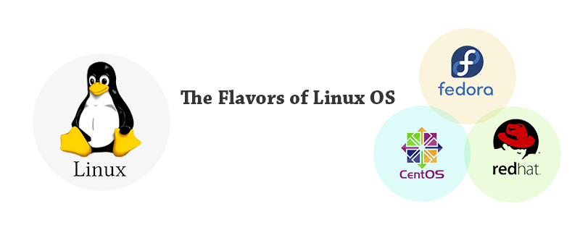
FEDORA: This flavor of operating system is the foundation for the commercial red hat Linux version. It weighs more on features and functionality along with free software.
Red hat : Red Hat Enterprise commercializes its Linux distribution intended for Servers and workstations. It is the most favored version of Linux OS and relies on open source Fedora version
CentOS : CentOS is a community version of Red hat. It is a community project that takes the Red Hat Enterprise Linux code, removes all Red Hat’s trademarks, and makes it available for free use and distribution.

Slide 11
Difference between Linux and Windows
S.No | Linux | Windows
1. | Linux is a open source operating system. | While windows are the not the open source operating system.
2. | Linux is free of cost. | While it is costly.
3. | It’s file name case-sensitive. | While it’s file name is case-insensitive.
4. | In linux, monolithic kernel is used. | While in this, micro kernel is used.
5. | Linux is more efficient in comparison of windows. | While windows are less efficient.
6. | There is forward slash is used for Separating the directories. | While there is back slash is used for Separating the directories.
7. | Linux provides more security than windows. | While it provides less security than linux.
8. | Linux is widely used in hacking purpose based systems. | While windows does not provide much efficiency in hacking.

Slide 12
Difference between 32bit and 64bit OS
Sr. No. | Key | 32-bit OS. | 64-bit OS.
1 | Data and storage handling. | As the name suggests 32 bit OS handle and store less data as compared to 64 bit OS. More specifically 32-bit OS can address a maximum of 4 GB 4,294,967,296 bytes) of RAM | On the other hand, 64 bit OS can handle more data than 32 bit OS, in numbers, it can address 264 memory addresses, i.e actually 18-Quintillion GB of RAM.
2 | System compatibility. | A system with a 64-bit processor can run either of a 64-bit or 32-bit version of an operating system installed. | On the other hand systems with a 32-bit processor could run 32 bit OS properly but 64-bit OS would not run at its full capability.
3 | Performance | The 32-bit processor as compared to the 64-bit processor is less efficient in a factor of performance. | On the other hand, a 64-bit processor is more recommended for multitasking and other heavy application execution due to its high performance as compared to a 32-bit processor.

Slide 13
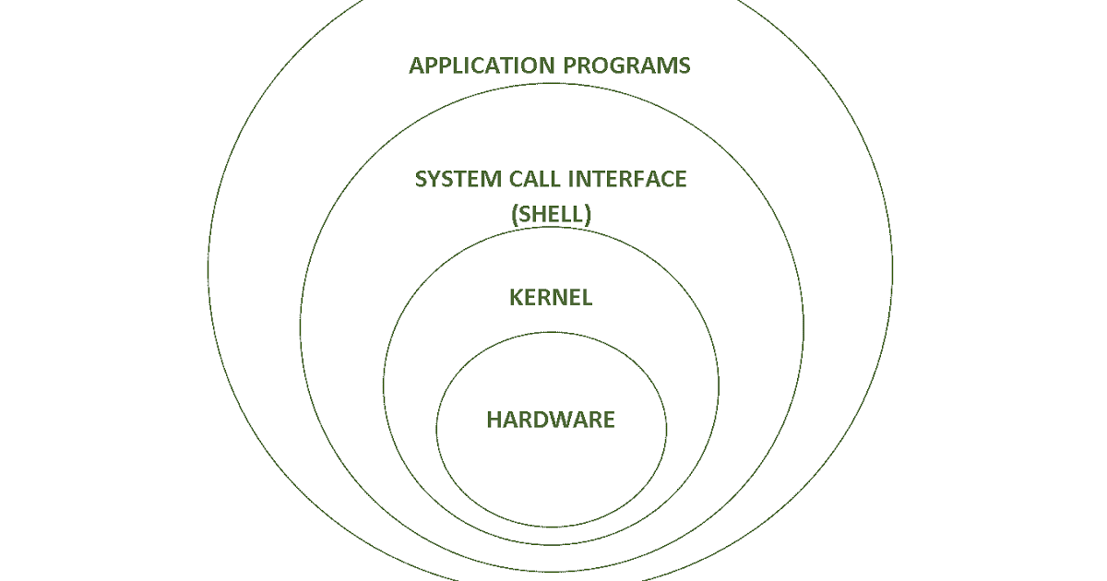
Architecture of UNIX operating system

Slide 14
The architecture of UNIX is basically divided into four main layers-
Kernel
Hardware
Shell
Files and directories
The first layer kernel deals with all the hardware connections all the applications and commands are associated with it. Hardware is the second layer. The third layer known as shell acts as the bridge between the user, user commands and predefined UNIX commands. Last but not the least files and directories can be concluded as the UNIX commands which will be UNIX programs in most cases. The final layer is the user. This means the whole operating system is visible to the user from the shell itself

Slide 15
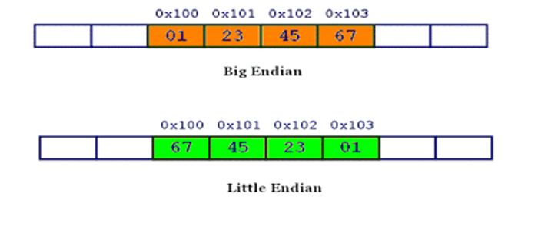
Little and big Endian
Little and big endian are two ways of storing multibyte data-types ( int, float, etc.)
In little endian machines, last byte of binary representation of the multibyte data-type is stored first.
In big endian machines, first byte of binary representation of the multibyte data-type is stored first.

Slide 16
What Is the OSI Model
The Open Systems Interconnection (OSI) model describes seven layers that computer systems use to communicate over a network. It was the first standard model for network communications, adopted by all major computer and telecommunication companies in the early 1980s
The modern Internet is not based on OSI, but on the simpler TCP/IP model. However, the OSI 7-layer model is still widely used, as it helps visualize and communicate how networks operate, and helps isolate and troubleshoot networking problems.
OSI was introduced in 1983 by representatives of the major computer and telecom companies, and was adopted by ISO as an international standard in 1984.

Slide 17
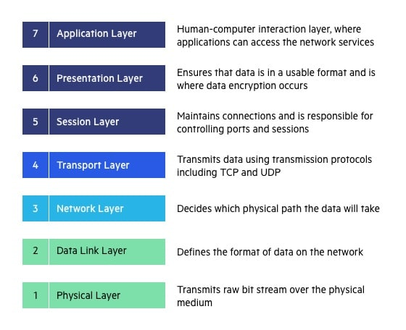
OSI 7 Layers:

Slide 18
The TCP/IP model is a part of the Internet Protocol Suite. This model acts as a communication protocol for computer networks and connects hosts on the Internet. It is a concise version of the OSI Model and comprises four layers in its structure.
TCP/IP Model:
Basics of TCP/IP Model
Full-Form | Transmission Control Protocol/ Internet Protocol
Developed By | Department of Defence (DoD), United States
Developed in | During the 1970s
Year for acknowledgement as a standard protocol by ARPANET | 1983
Function of TCP | Collecting and Reassembling Data Packets
Function of IP | Sending the Data Packets to the correct destination
Number of Layers in TCP/IP Model | 4 layers

Slide 19
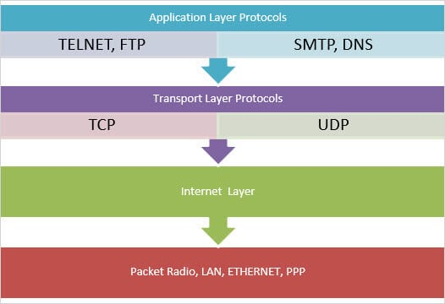
TCP/IP layers:

Slide 20
Monolithic kernel vs Microkernel
A kernel is a software that forms a layer between the hardware and the operating system; it is divided into two main types, i.e. Monolithic kernel and Microkernel; these types are mainly segregated based upon how they manage the process, along with this they also differ in the field of execution-style, size, speed, stability, inter-process communication, Extensibility, Maintainability, Debug, Security, etc., along with these differences its important to note that Monolithic kernel is much older than microkernels and are used in Linux while microkernels are used in Mac OS.
There are different types of kernel. The two main types are namely:
Monolithic kernel
Microkernel
These kernel types are segregated based on how they manage a request from a process (also known as system calls) and resources. Monolithic kernels are much older than microkernels. Microkernels were discovered in the late 1980s.

Slide 21
Basis of Comparison | Monolithic Kernel | MicroKernel
Execution Style | All processes are executed under the kernel space in privileged mode. | Only the most important processes take place in the Kernel space. All other processes are executed in the user space.
Size | Kernel size is bigger when compared to Microkernel. | Kernel size is smaller with respect to the monolithic kernel.
Speed | It provides faster execution of processes. | Process execution is slower.
Stability | A single process crash will cause the entire system to crash. | A single process crash will have no impact on other processes.

Slide 22
Basis of Comparison | Monolithic Kernel | MicroKernel
Inter-Process Communication | Use signals and sockets to achieve interprocess communication. | Use messaging queues to achieve inter-process communication.
Extensibility | Difficult to extend. | Easily extensible.
Maintainability | Maintenance is more time and resource consuming. | Easily maintainable
Debug | Harder to debug | Easier to debug
Security | Less Secure. | More Secure
Example | Linux | Mac OS

